Slide 1
Voluntary Framework of Accountability
Year One Student Progress & Outcomes
Data Concepts
Core Concepts:
Mott Community College (MCC) developed an 8 year longitudinal student data set for reporting against. The data set has the capacity to
serve multiple functions beyond VFA, such as the new IPEDS outcomes metrics, internal program review, and internal progress and
retention analysis.
The concept is based on utilizing our IPEDS Fall Enrollment master data file as the basis for VFA cohort development, which is then merged
with student demographic and progression data from our student information system (Ellucian Colleague/Datatel).
Data tables are developed through extracts of the MCC data warehouse utilizing IBM Cognos Report Studio as a BI interface. Data tables
are then warehoused and available for analysis and reporting to VFA or other entities.
Mott Community College Institutional Research; VFA Year One

Slide 2
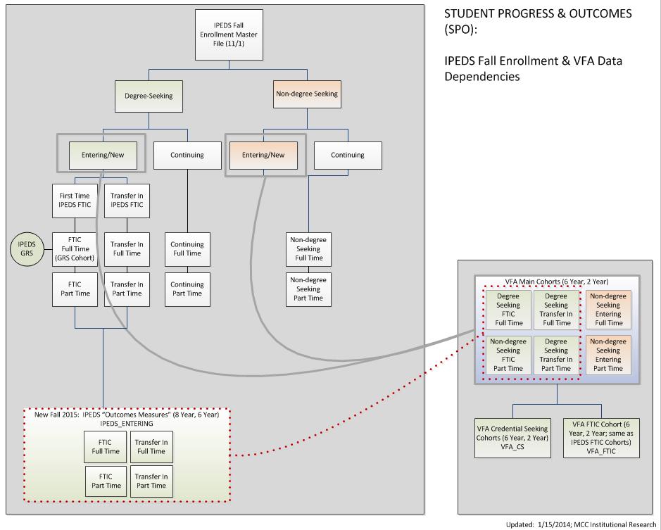
VFA and IPEDS Cohort Concepts:
IPEDS Fall Enrollment serves as the driver for the VFA and IPEDS reporting cohorts
Mott Community College Institutional Research; VFA Year One

Slide 3
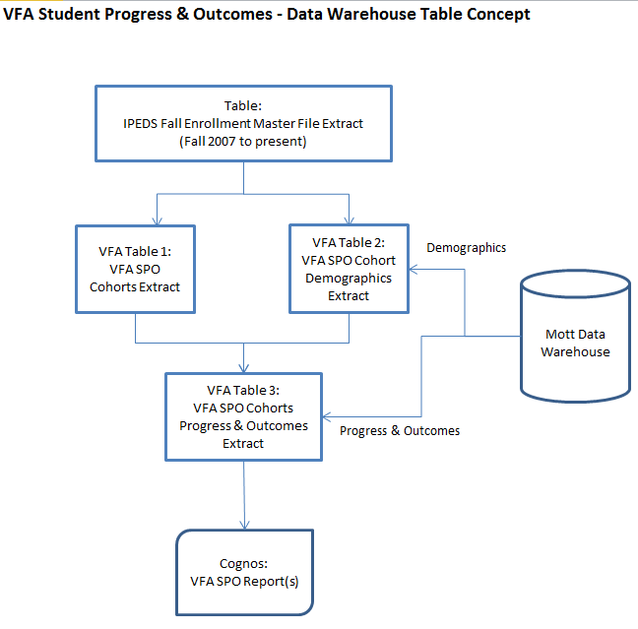
Core Concepts: IPEDS Fall Enrollment drives cohort generation. Annually, student cohort data are extracted from Ellucian Colleague (Datatel), transformed with demographic and progression data, and appended to the master Student Progress & Outcomes table for reporting. Eight years of longitudinal data are warehoused at the student level and aggregated for reporting.
Mott Community College Institutional Research; VFA Year One

Slide 4
VFA Student Progress & Outcomes Reporting Dataset Elements
Mott Community College Institutional Research; VFA Year One

Slide 5
VFA Student Progress & Outcomes Reporting Dataset Elements
Mott Community College Institutional Research; VFA Year One

Slide 6
VFA and IPEDS Cohort: Longitudinal cohort and SPO extract timing
Mott Community College Institutional Research; VFA Year One; Draft

Slide 7
Sample VFA Output: “COHORTS_DISAGGREGATED”
IBM Cognos Report Studio is used to build reports for the VFA bulk upload process. Reports are exported to Excel from Cognos and then
manually pivoted and copy/pasted into the VFA upload template.
Cognos output:
Excel pivot for upload template:
Mott Community College Institutional Research; VFA Year One

Slide 8
Voluntary Framework of Accountability
Year One Student Progress & Outcomes
Data Concepts
Contact:
Lori Hancock
Director of Institutional Research
lori.hancock@mcc.edu

